Slide 1
3. A English lesson
Wednesday, 22 April 2020

Slide 2
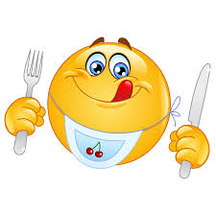
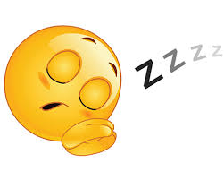
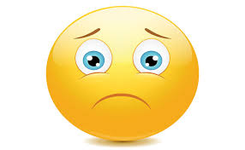
How are you today? ☺
I am fine.
I am happy.
I am great.
I am tired.
I am hungry.
I am sad.

Slide 3
Who is in the picture? Activity book page 59/2 There is…
woman
man
baby
boy
dog
girl

Slide 4
What is it like? Activity book page 62/2 The dog/ Giraffe/ Hippo/ boy/ snake/ chick is…...

Slide 5
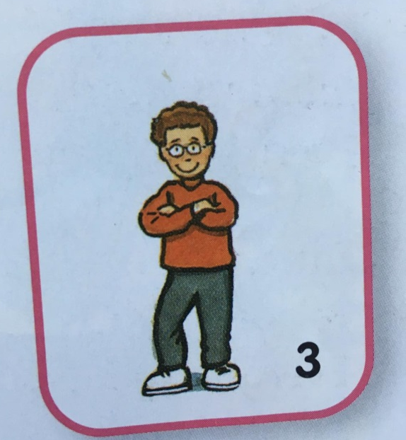
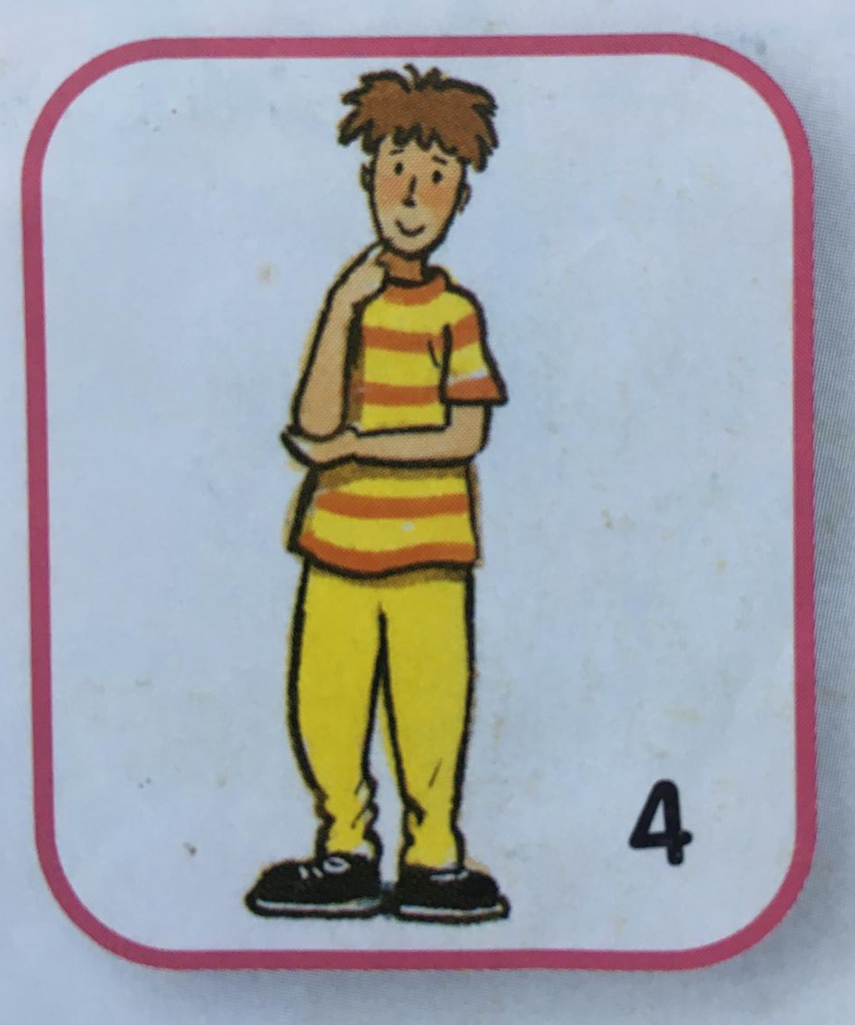
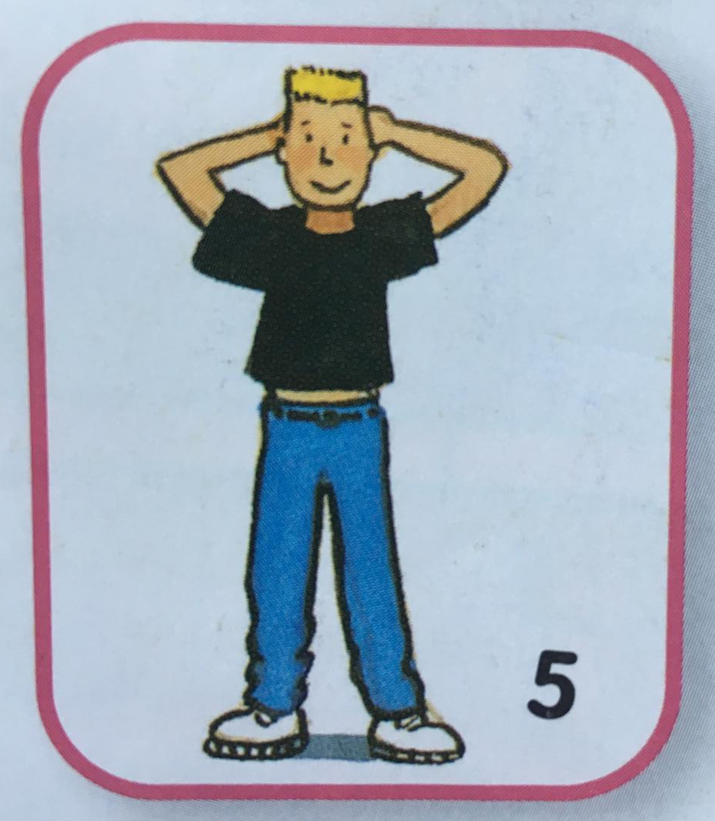
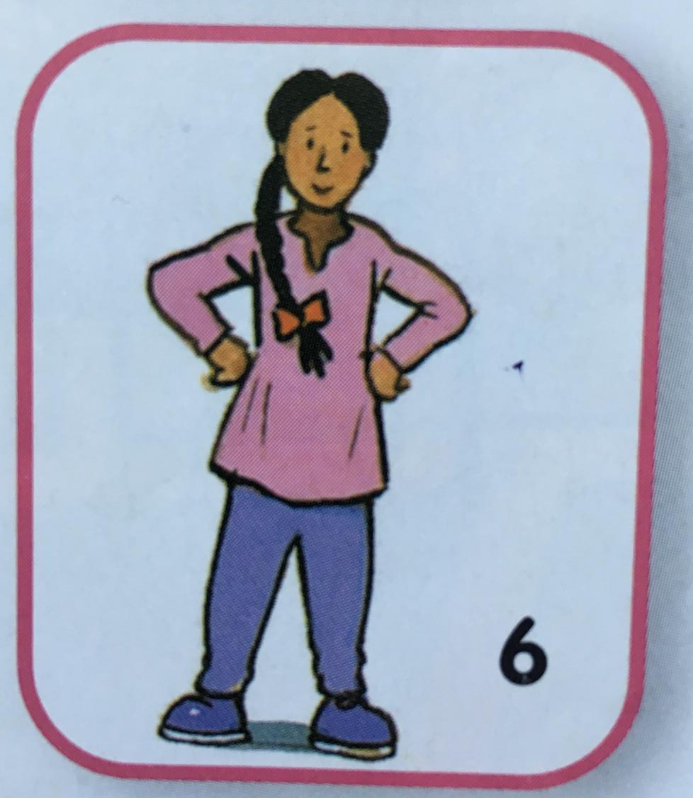
She has got / He has got…
Blond hair
Brown hair
Black hair
Short hair
Long hair

Slide 6
Is it true or false? Je to pravda nebo lež?
1
3
5
She has got blond hair.
She is a fat girl.
He has got black hair.
2
4
6
He is an old woman.
He has got long hair..
He is a tall boy.

Slide 7
Draw a picture ☺ obrázek mi můžete poslat na email.
It is a man.
He is old.
He is short.
He is fat.
He has got short brown hair.
He has got blue eyes.
He is wearing green T-Shirt with an Easter bunny.
He has got a basket with five Easter eggs.

Slide 8
Have a nice day ☺
Co jsme neudělali společně, dodělej si sám:
https://www.zsposepneho.cz/zaci/tridy/3-a/vyuka/aj-22-4-english-lesson-22nd-april.3871

